Slide 1
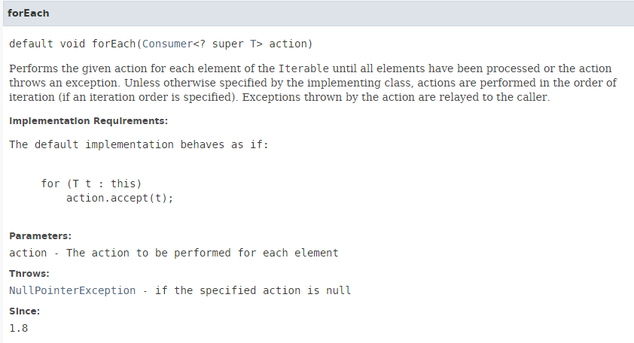
forEach

Slide 2
forEach
https://docs.oracle.com/javase/8/docs/api/index.html?java/lang/Iterable.html

